Slide 1
MUSIC STORE MANAGEMENT

Slide 2
MUSIC STORE MANAGEMENT

Slide 3
The Composers
D. Sai Sumanth
Background – B.Tech CSE AI/ML, BATCH - 433
V. Amarnath Reddy
Background – B.Tech CSE AI/ML, BATCH - 433
M. Aravind
Background – B.Tech ECE, BATCH - 433

Slide 4

INTRODUCTION
In this project, we conducted a comprehensive analysis of music store data using MySQL to uncover key insights into customer behavior, music genre preferences, and sales performance.
By leveraging advanced SQL queries, we explored patterns in revenue, top-spending customers, most popular genres by country, and best-selling tracks and artists.
This analysis supports data-driven decision-making for promotional planning, market segmentation, and inventory optimization.

Slide 5
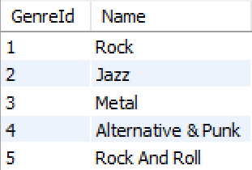
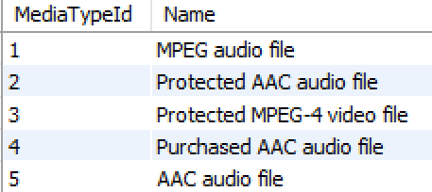
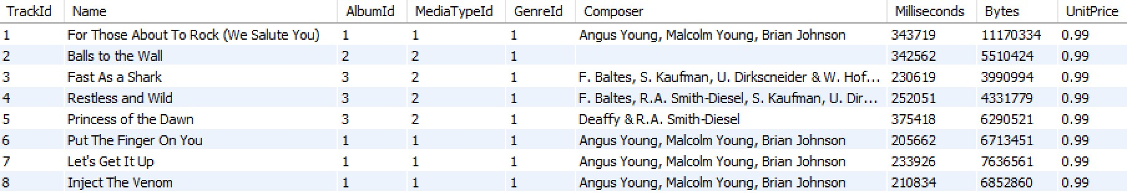
TABLES
Genre
MediaType
Track

Slide 6
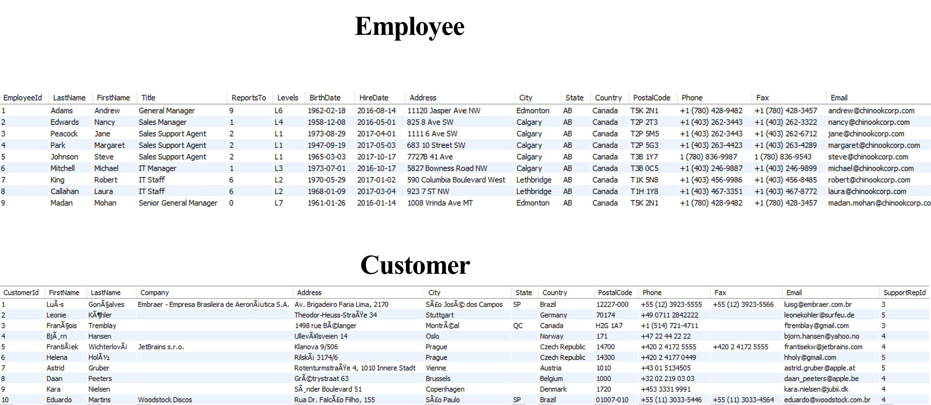

Slide 7
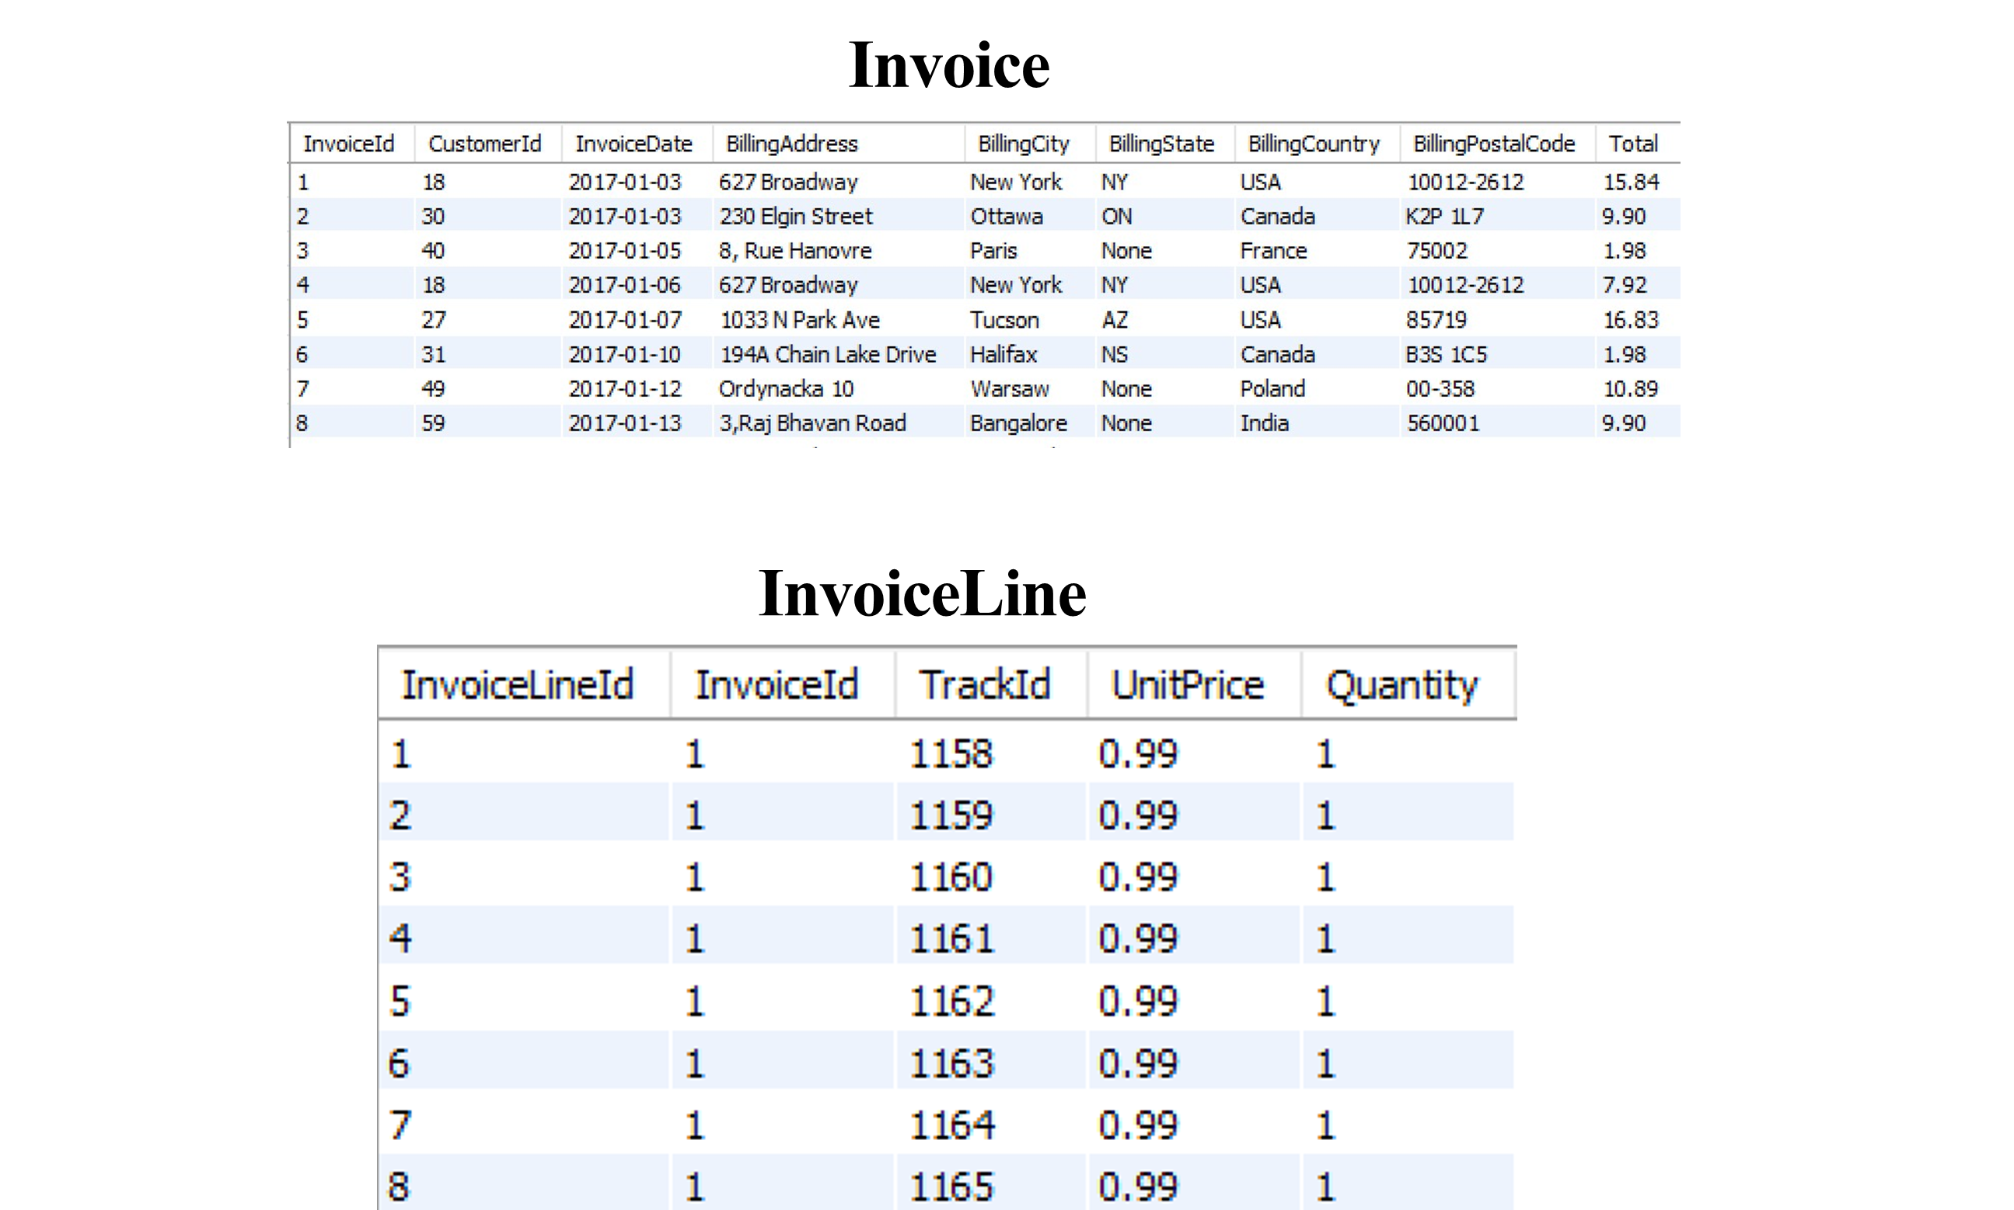

Slide 8
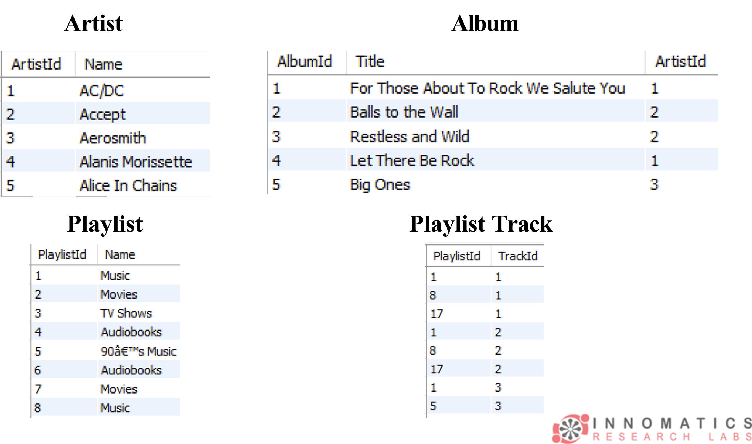

Slide 9
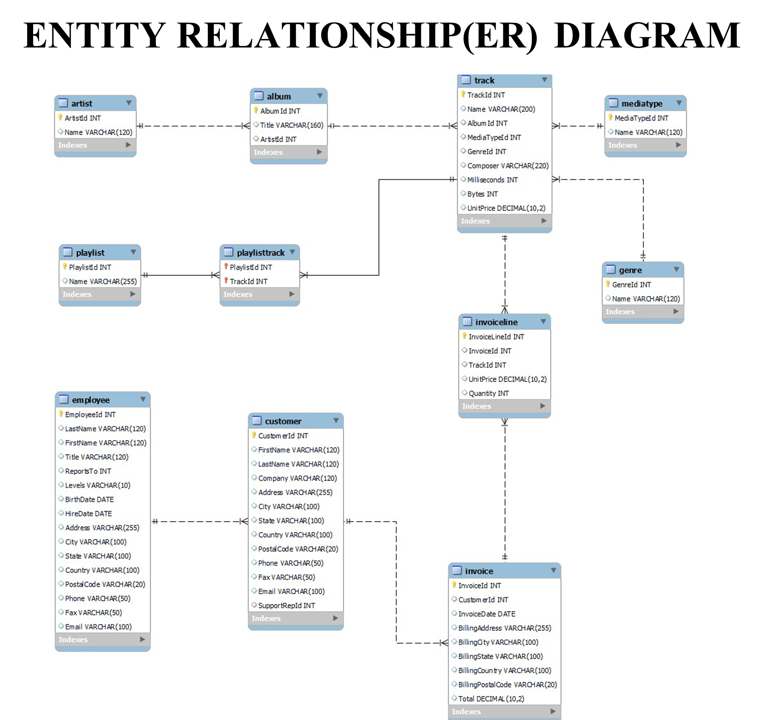

Slide 10
PROBLEM STATEMENT
Analyze sales performance across countries and cities to identify top markets and revenue sources.
Identify top customers based on spending behavior and track their musical preferences by genre and artist.
Discover popular music genres and high-performing tracks to inform marketing and playlist strategies.
Evaluate artist contributions, especially in the Rock genre, to target promotional opportunities and events.
Segment customers by region a tailor promotions, identify high-value users, and understand country-specific trends.

Slide 11

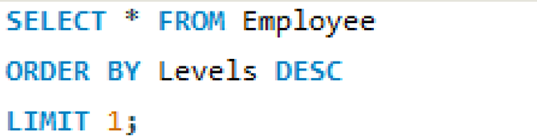

Slide 12
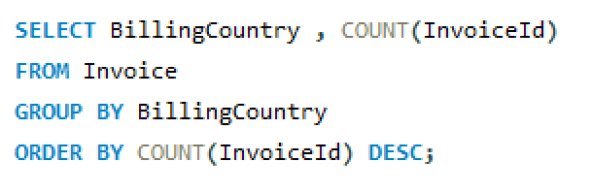
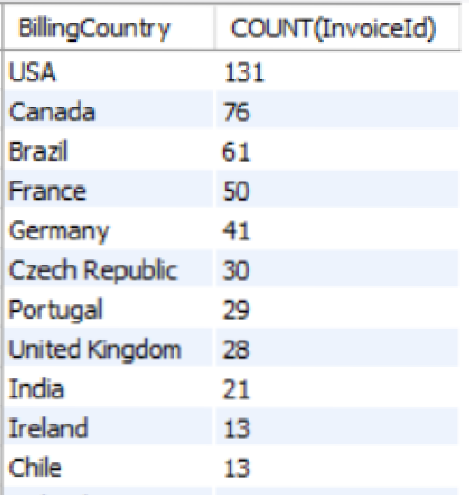

2 . Which countries have the most Invoices?

Slide 13
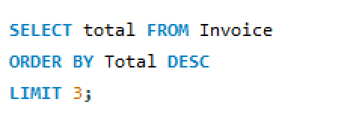

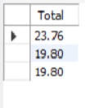
3.What are the top 3 values of total invoice?

Slide 14
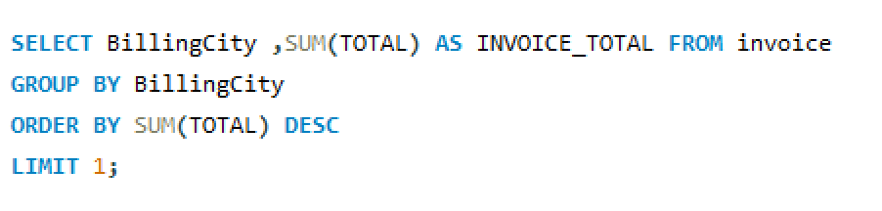

4. Which city has the best customers? We would like to throw a promotional Music Festival in the city we made the most money. Write a
Query that returns one city has the highest sum of invoice totals. Return both the city name & sum of all invoice totals.

Slide 15
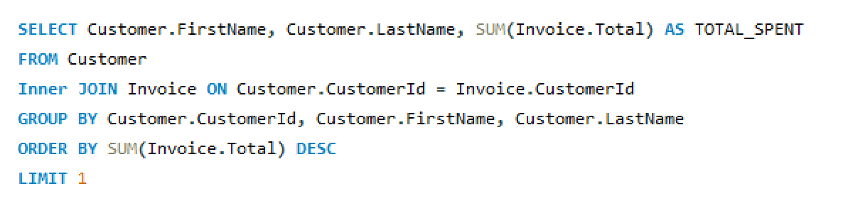

5. Who is the best customer? The customer who has spent the most money will be declared the best customer. Write a query that returns the person who has spent the most money

Slide 16
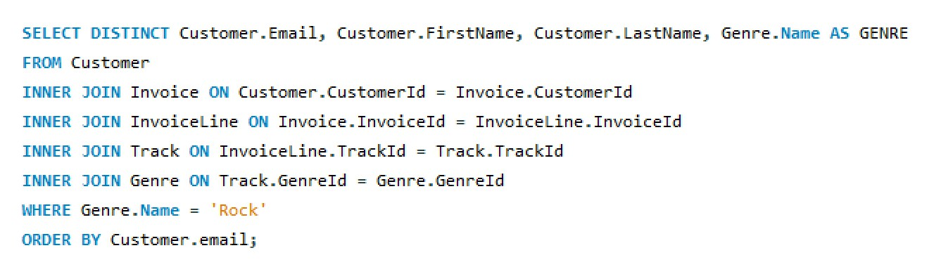

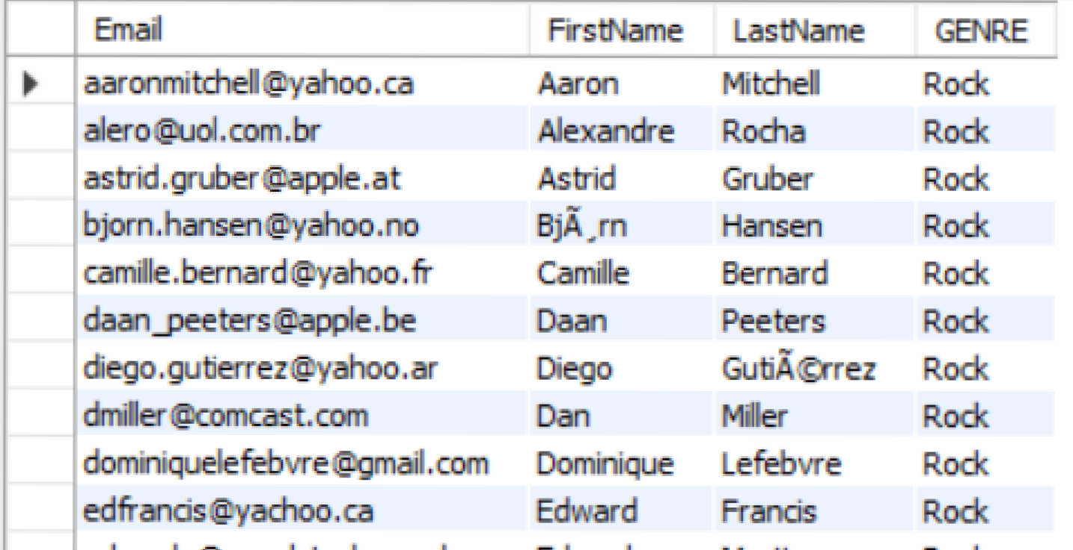
6. Write a query to return the email, first name, last name, & Genre of all Rock Music listeners. Return your list ordered alphabetically by email starting with A

Slide 17

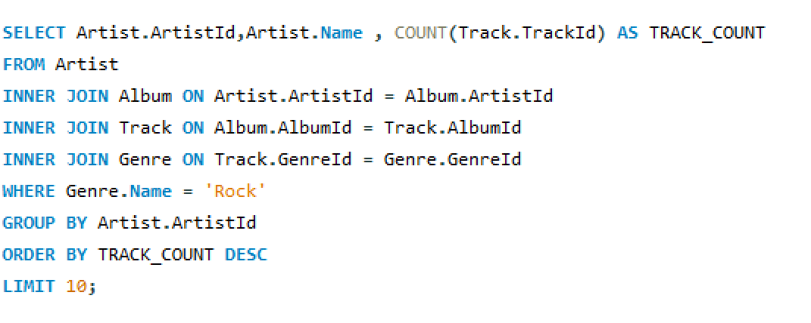
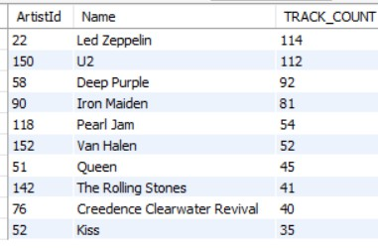
7. Let's invite the artists who have written the most rock music in our dataset. Write a query that returns the Artist name and total track count of the top 10 rock bands

Slide 18
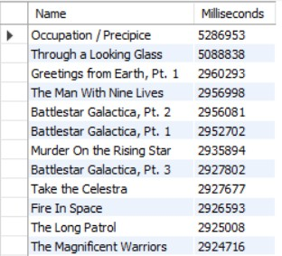
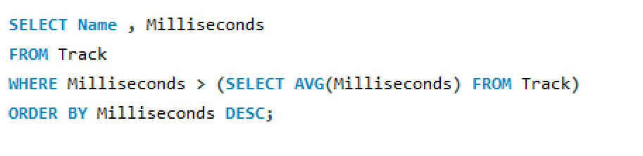
8. Return all the track names that have a song length longer than the average song length. Return the Name and Milliseconds for each track. Orderby the song length with the longest songs listed first.

Slide 19
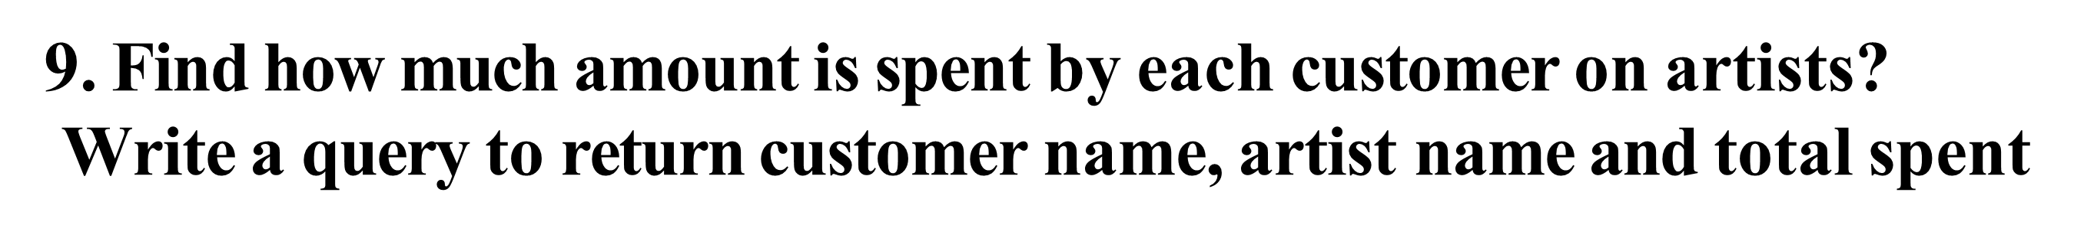
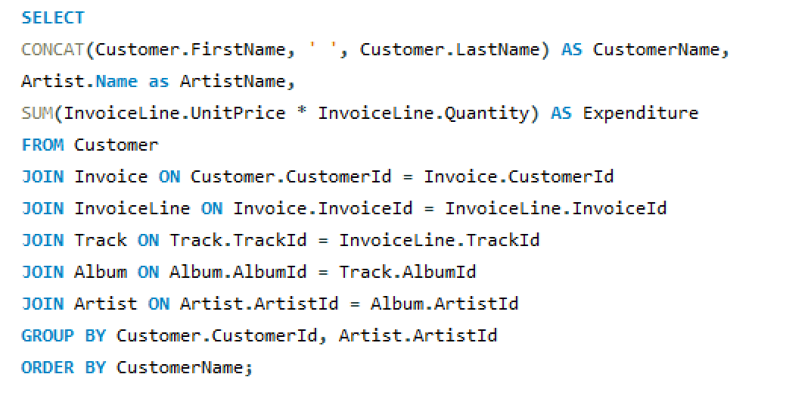
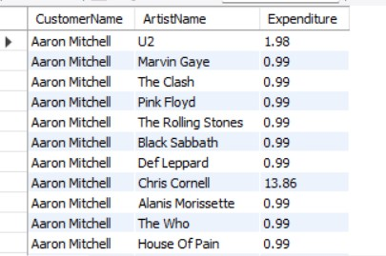

Slide 20
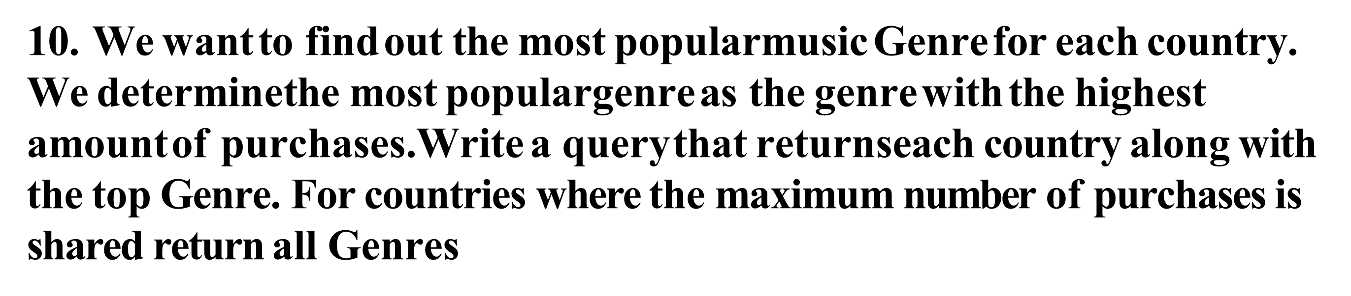
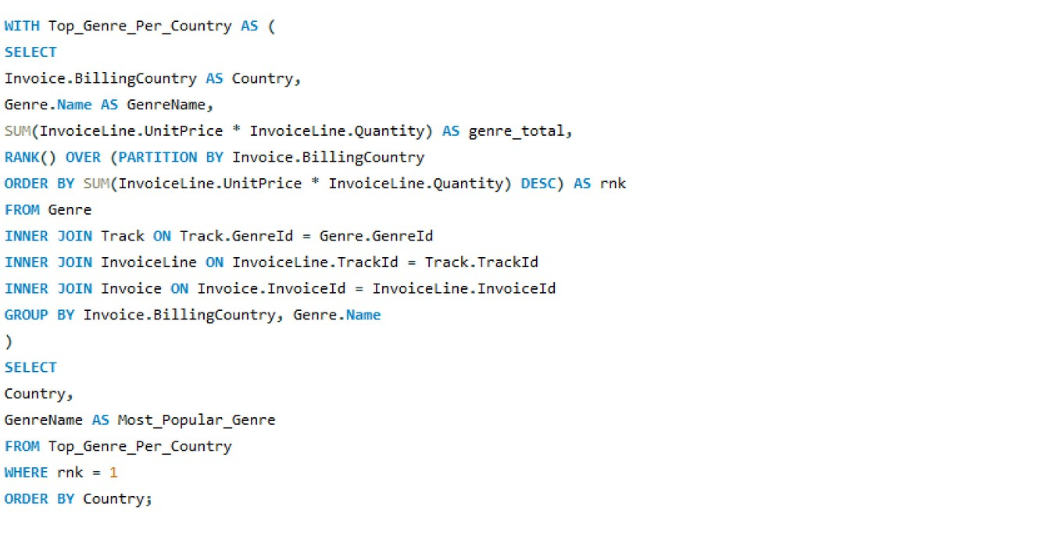
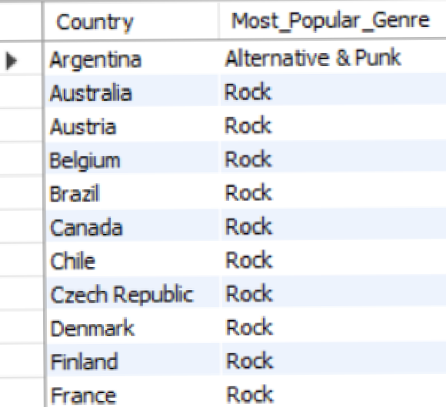


Slide 21
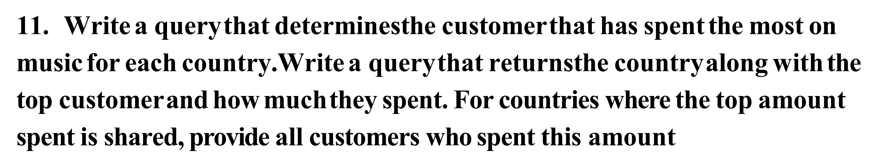
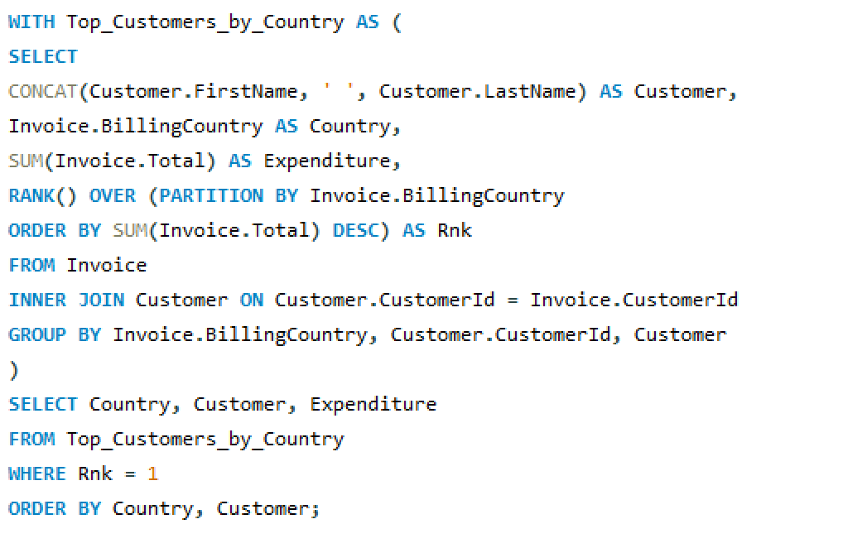
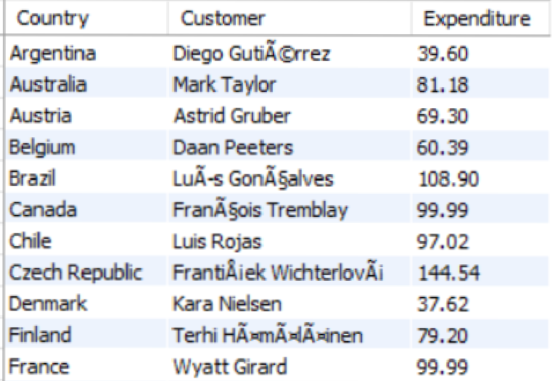


Slide 22
THANK YOU

